Slide 1


Real-Time Detection of Car and Pedestrian for Visually Impaired People
5TH INTERNATIONAL CONFERENCE ON INTELLIGENT
COMPUTING (ICONIC 2K22)
Paper Id : 16
Presented by:
Dr. Shripad Bhatlawande, Aditya Lashkare, Aslam Ali,
Dr. Swati Shilaskar, Prof. Jyoti Madake
Vishwakarma Institute of Technology, Pune, India

Slide 2
INDEX
5TH INTERNATIONAL CONFERENCE ON INTELLIGENT COMPUTING (ICONIC 2K22)
01 | INTRODUCTION
02 | LITERATURE REVIEW
03 | RESEARCH GAP
04 | NOVELTY
05 | METHODOLOGY
06 | RESULTS
07 | CONCLUSION

Slide 3
INTRODUCTION
01
253 million visually impaired people in the world
02
As per census 2021, 17.13 million dogs and 5 million cattle in India
03
Safe and Secure mobility is a challenge for visually impaired
04
Mobility and Navigation Difficulties can be solved with Electronic Travel Assistance
5TH INTERNATIONAL CONFERENCE ON INTELLIGENT COMPUTING (ICONIC 2K22)

Slide 4
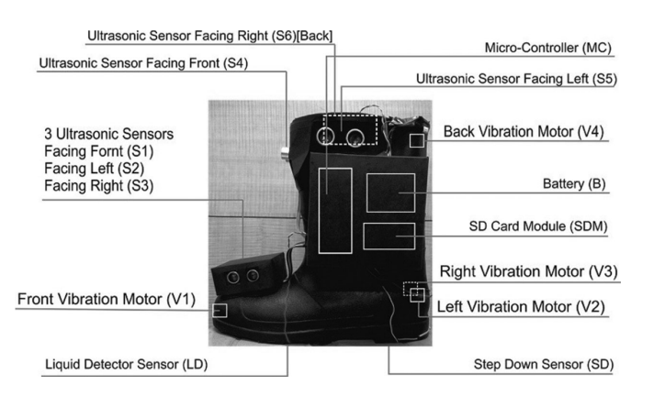
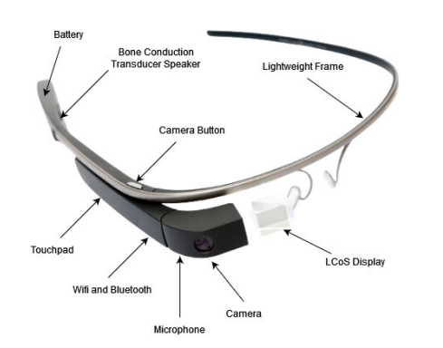
LITERATURE REVIEW
Design and Construction of Electronic Aid for Visually Impaired People [1]
Multiple ultrasonic sensor
Obstacle detection
A Google Glass Based Real-Time Scene Analysis for the Visually Impaired [2].
Google glass based
Scene Recognization
5TH INTERNATIONAL CONFERENCE ON INTELLIGENT COMPUTING (ICONIC 2K22)

Slide 5
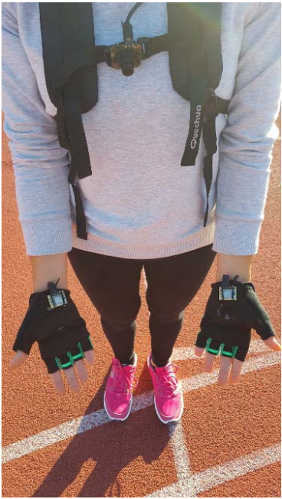
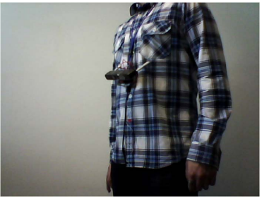
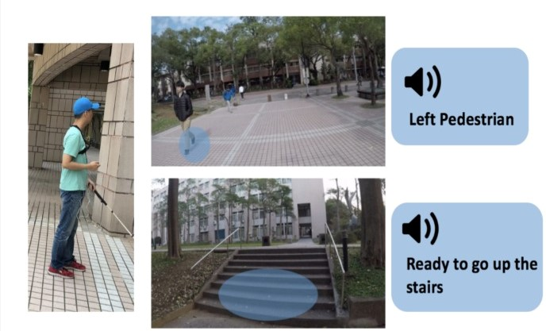
LITERATURE REVIEW
Mechatronic System To Help Visually Impaired Users During Walking And Running [3] .
Help to walk or run in an only single track on ground.
Tactile feedback
V-Eye: A Vision-Based Navigation system for visually impaired [4].
Localization and Auditory feedback
Image segmentation techniques
Navigation Assistance for the Visually Impaired Using RGB-D Sensor With Range Expansion [5].
Sensor is Red Green Blue-Depth.
Object is detected by using depth.
5TH INTERNATIONAL CONFERENCE ON INTELLIGENT COMPUTING (ICONIC 2K22)

Slide 6

RESEARCH GAP
Acceptability among visually impaired
Lack of useful functions
Bulky and heavy computational hardware
Ergonomic design
Expensive
5TH INTERNATIONAL CONFERENCE ON INTELLIGENT COMPUTING (ICONIC 2K22)

Slide 7

NOVELTY
Accurate Detection of Person & Car
Low Computational hardware
Easy to carry
Low powered embedded system
Auditory feedback
5TH INTERNATIONAL CONFERENCE ON INTELLIGENT COMPUTING (ICONIC 2K22)

Slide 8

METHODOLOGY
5TH INTERNATIONAL CONFERENCE ON INTELLIGENT COMPUTING (ICONIC 2K22)

Slide 9
BLOCK DIAGRAM OF SYSTEM
Camera
Image Pre-Processing
Processor-based System
Car & Person Detection
Wired Earphone
Audio Signal Generation
5TH INTERNATIONAL CONFERENCE ON INTELLIGENT COMPUTING (ICONIC 2K22)

Slide 10
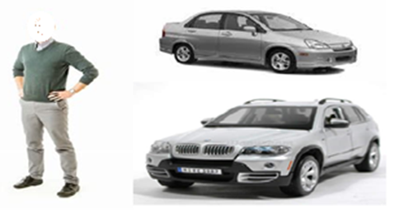
DATASET
Sr. No. | Type | No. of Images | Class
1 | Car | 3000 | 0
2 | Person | 3000 | 1
3 | Negative | 3000 | 2
5TH INTERNATIONAL CONFERENCE ON INTELLIGENT COMPUTING (ICONIC 2K22)

Slide 11
FEATURE EXTRACTION: ORB
Img. 1
ORB features of Img. 1
ORB Feature Vector
3millonx32
Img. 2
ORB features of Img. 2
Img. 9000
ORB features of Img. 9000
5TH INTERNATIONAL CONFERENCE ON INTELLIGENT COMPUTING (ICONIC 2K22)

Slide 12
COMPILATION OF OPTIMIZED FEATURE VECTOR:
Feature extraction and Grounding the features
Novel Blend of K-Means and PCA
K-Means: Dividing Feature Vector in 5 clusters (9,000x5)
Prediction performed on Pertained K-Means Clustering Model.
PCA: Optimize Feature Vector to 9,000x3
5TH INTERNATIONAL CONFERENCE ON INTELLIGENT COMPUTING (ICONIC 2K22)

Slide 13
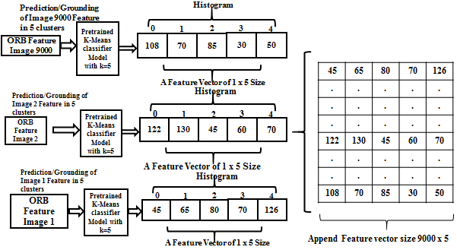
K-Means:
5TH INTERNATIONAL CONFERENCE ON INTELLIGENT COMPUTING (ICONIC 2K22)

Slide 14
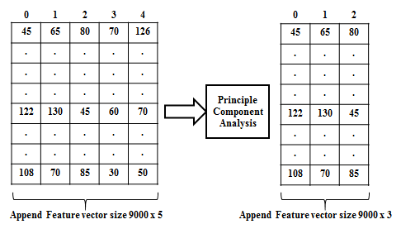
PCA:
5TH INTERNATIONAL CONFERENCE ON INTELLIGENT COMPUTING (ICONIC 2K22)

Slide 15
CLASSIFICATION:
0%
100%
80%
20%
Dataset Splitting
01
02
Decision tree
Random Forest
03
Machine Learning
Classifiers
04
KNN
SVM
05
Logistic Regression
5TH INTERNATIONAL CONFERENCE ON INTELLIGENT COMPUTING (ICONIC 2K22)

Slide 16
RESULTS
Performance Evaluation-I
RANDOM FOREST
1
5TH INTERNATIONAL CONFERENCE ON INTELLIGENT COMPUTING (ICONIC 2K22)

Slide 17
RESULTS
Performance Evaluation-II
Sr .No | Performance Metric Classifier | Recall | Precision | F1 Score
1. | Random Forest | 0.94 | 0.88 | 0.91
2. | Decision Tree | 0.93 | 0.86 | 0.90
3. | KNN | 0.84 | 0.86 | 0.85
4. | SVM | 0.82 | 0.80 | 0.82
5. | Logistic Regression | 0.82 | 0.85 | 0.81
5TH INTERNATIONAL CONFERENCE ON INTELLIGENT COMPUTING (ICONIC 2K22)

Slide 18
COMPARISION OF EXISTING SYSTEM
Name | Features | Form | Feedback | Accuracy
Smart Shoe Electronic Aid [1] | a. Object Detection b. Mobility | Shoes | Tactile | 88%
Smart Google Glass [2] | a. Mobility | Spectacles | Auditory | 85-90%
Mechatronics smart system [3] | a. Mobility b. Navigation | Gloves | Tactile | 87%
Proposed System | a. Object Detection b. Mobility | Wearable band or cloth | Auditory | Object Detection: 90%
5TH INTERNATIONAL CONFERENCE ON INTELLIGENT COMPUTING (ICONIC 2K22)

Slide 19


CONCLUSION
The System recognizes object (car / pedestrian).
Auditory Feedback On Detection Of Object.
Fast and accurate detection (90 % accuracy).
Assistance to travel independently and safely.
Expansion to detect more objects.
Obstacle Distance measurement can be added.
5TH INTERNATIONAL CONFERENCE ON INTELLIGENT COMPUTING (ICONIC 2K22)

Slide 20
REFERENCES
[1] Patil, Kailas; Jawadwala, Qaidjohar; Shu, Felix Che (2018). Design and Construction of Electronic Aid for Visually Impaired People. IEEE Transactions on Human-Machine Systems, (), 1–11. doi:10.1109/THMS.2018.2799588
[2] Rao, Sanjeev U., Swaroop Ranganath, T. S. Ashwin, and Guddeti Ram Mohana Reddy. "A Google Glass Based Real-Time Scene Analysis for the Visually Impaired." IEEE Access 9 (2021): 166351-166369.
[3] Frontoni And P. Zingaretti,A. Mancini, E. "Mechatronic System To Help Visually Impaired Users During Walking And Running," In Ieee Transactions On Intelligent Transportation Systems, Vol. 19, No. 2, Pp. 649-660, Feb. 2018, Doi: 10.1109/Tits.2017.2780621.
[4] Duh, Ping-Jung; Sung, Yu-Cheng; Fan Chiang, Liang-Yu; Chang, Yung-Ju; Chen, Kuan-Wen (2020). V-Eye: A Vision-based Navigation System for the Visually Impaired. IEEE Transactions on Multimedia, (), 1–1. doi:10.1109/TMM.2020.3001500
[5] Aladren, A.; Lopez-Nicolas, G.; Puig, Luis; Guerrero, Josechu J. (2014). Navigation Assistance for the Visually Impaired Using RGB-D Sensor With Range Expansion. IEEE Systems Journal, (), 1–11. doi:10.1109/JSYST.2014.2320639
5TH INTERNATIONAL CONFERENCE ON INTELLIGENT COMPUTING (ICONIC 2K22)

Slide 21
REFERENCES
[6] X. Zhang, B. Li,J. Xiao, S. L. Joseph, X. Li And J. Zhang, "An Assistive Navigation Framework For The Visually Impaired," In Ieee Transactions On Human-Machine Systems, Vol. 45, No. 5, Pp. 635-640, Oct. 2015, Doi: 10.1109/Thms.2014.2382570.
[7] L. -Y. F. Chiang, Chang And K. -W. Chen,P. -J. Duh, Y. -C. Sung, Y. -J. "V-Eye: A Vision-Based Navigation System For The Visually Impaired," In Ieee Transactions On Multimedia, Vol. 23, Pp. 1567-1580, 2021, Doi: 10.1109/Tmm.2020.3001500.
[8] D. Croce Et Al., "An Indoor And Outdoor Navigation System For Visually Impaired People," In Ieee Access, Vol. 7, Pp. 170406-170418, 2019, Doi: 10.1109/Access.2019.2955046.
[9] V. Garaj And W. Balachandran, Z. Hunaiti, "An Assessment Of A Mobile Communication Link For A System To Navigate Visually Impaired People," In Ieee Transactions On Instrumentation And Measurement, Vol. 58, No. 9, Pp. 3263-3268, Sept. 2009, Doi: 10.1109/Tim.2009.2022374
[9] L. Jin And C. Ye, H. Zhang, "An Rgb-D Camera Based Visual Positioning System For Assistive Navigation By A Robotic Navigation Aid," In Ieee/Caa Journal Of Automatica Sinica, Vol. 8, No. 8, Pp. 1389-1400, August 2021, Doi: 10.1109/Jas.2021.1004084.
[10] B. Ando, "A Smart Multisensor Approach To Assist Blind People In Specific Urban Navigation Tasks," In Ieee Transactions On Neural Systems And Rehabilitation Engineering, Vol. 16, No. 6, Pp. 592-594, Dec. 2008, Doi: 10.1109/Tnsre.2008.2003374.
5TH INTERNATIONAL CONFERENCE ON INTELLIGENT COMPUTING (ICONIC 2K22)

Slide 22
THANK YOU
We Would Like To Extend Our Sincere Gratitude and Thank The Reviewers, Organizing Committee Members, and Respected Session Chairs, for Giving us the Opportunity to Present Our Research Paper.
ICONIC 2K22
5TH INTERNATIONAL CONFERENCE ON INTELLIGENT COMPUTING

